Slide 1
AI-Powered Cybersecurity Threat Monitoring
Towa Arnold
[tda0038@arastudent.ac.nz]

Slide 2
Objectives
Collect and prepare suitable network traffic datasets
Develop an AI model for attack detection
Create a data preprocessing pipeline
Integrate AI predictions with Elastic Cloud and Kibana
Test the system in a virtual environment
Document the implementation and risks

Slide 3
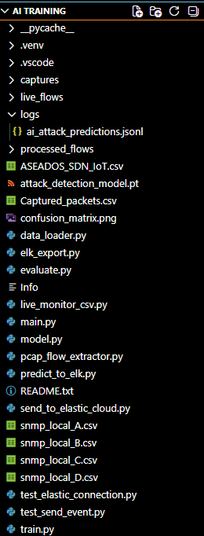
Creation of the AI
2.57GB Total
921 Files
ai_attack_predictions.jsonl contains millions of row of data
30-40min training time

Slide 4
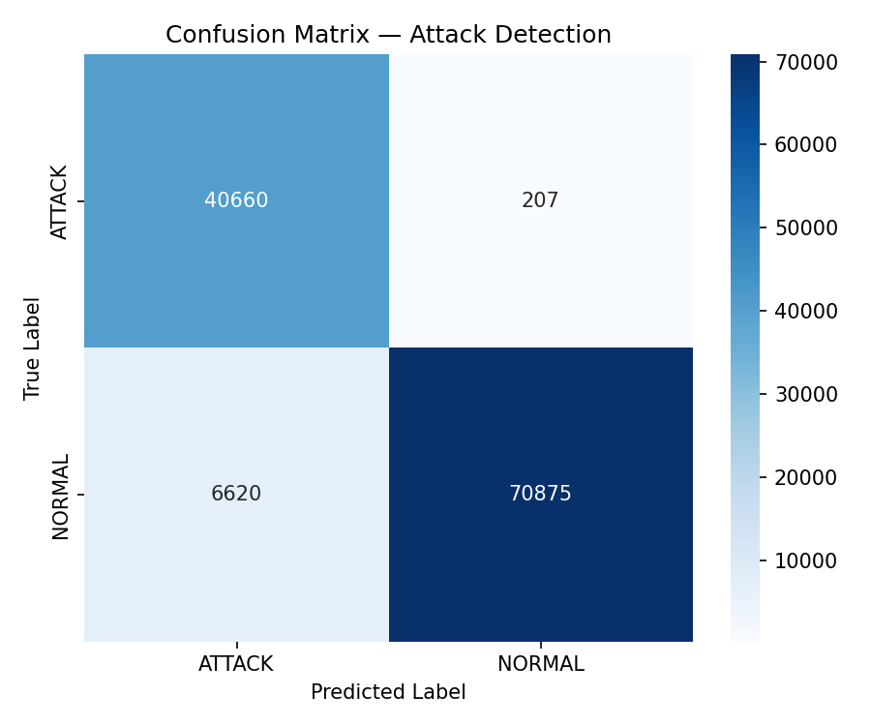
Confusion Matrix
A table to evaluate the performance of a classification model
Is generated after running main.py
4 distinct metrics
  True Normal
  True Attack
  False Normal
  False Attack

Slide 5
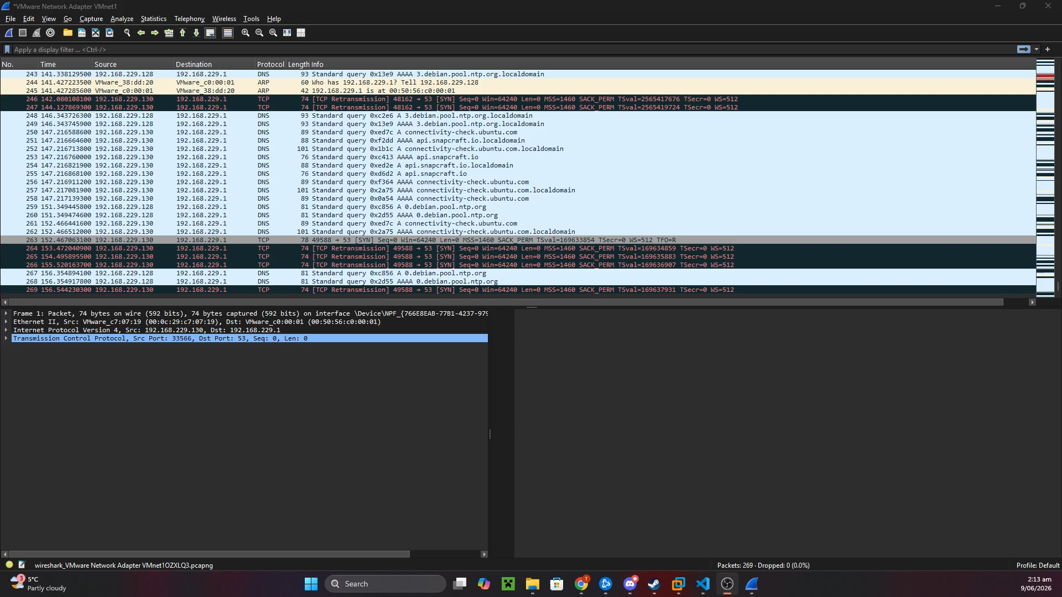
Demonstration

Slide 6

Limitations
Trained with mixed datasets
Does not provide detailed attack type classification
Does not truly reflect real world scenarios
Some features may not always be available for live monitoring, e.g. flow-level features generated by CICFlowMeter-style tools

Slide 7
Future Improvements
Multi-class attack detection
Automated real-time monitoring
Security hardening
Performance optimisation

